Slide 1
Space Shooter Game
RollNo TYCS38

Slide 2
Game component
Asteroid
Player
Score
Three Level
Sound-like start game, background sound, bullet fire sound, explosion sound.

Slide 3
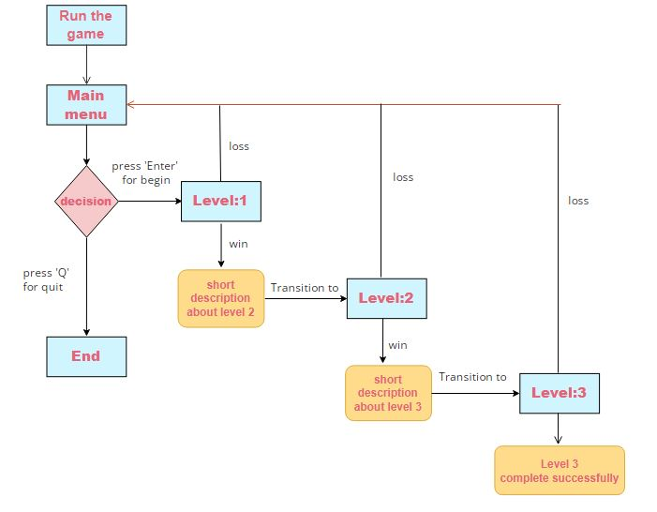
Block diagram

Slide 4
Algorithm
Step1: select Q for quit or Enter for start.
Step2: if player select “enter”, go to step 3. Else go to step 7
Step3: start game, now player can move left or right and destroyed asteroids.
Step4: if player_score>elapsed(time taken) + randomtime(range(2,10)) +level*10+10 then go to step 5. Else continue.
Step5: go to next level.
Step6: if player contact with asteroid, go to step 7.
Step7: Quit

Slide 5
Leval:2
Different from Level 1 are:
Background
Falling speed
More and diferent Asteroids
Level:3
Different from level two are:
Falling asteroids speed increased
Bird flying from left to right
If you by mistake kill birds, your score will reduced by 2.

